Slide 1

CCAS 4.3 - Clothing Ecommerce System
Developed by Adham Walid, Omar El Farouk, and Youssef El Shamy.

Slide 2

Clothing Ecommerce System
Our clothing ecommerce system provides an efficient and personalized online shopping experience. Key features include:
1
Convenient Access
2
Informed Decisions
3
Personalized Experience
Shop the latest fashion trends anytime, anywhere on our user-friendly platform.
Compare product details side-by-side to find the perfect item.
improve user experience by adding personalized features

Slide 3
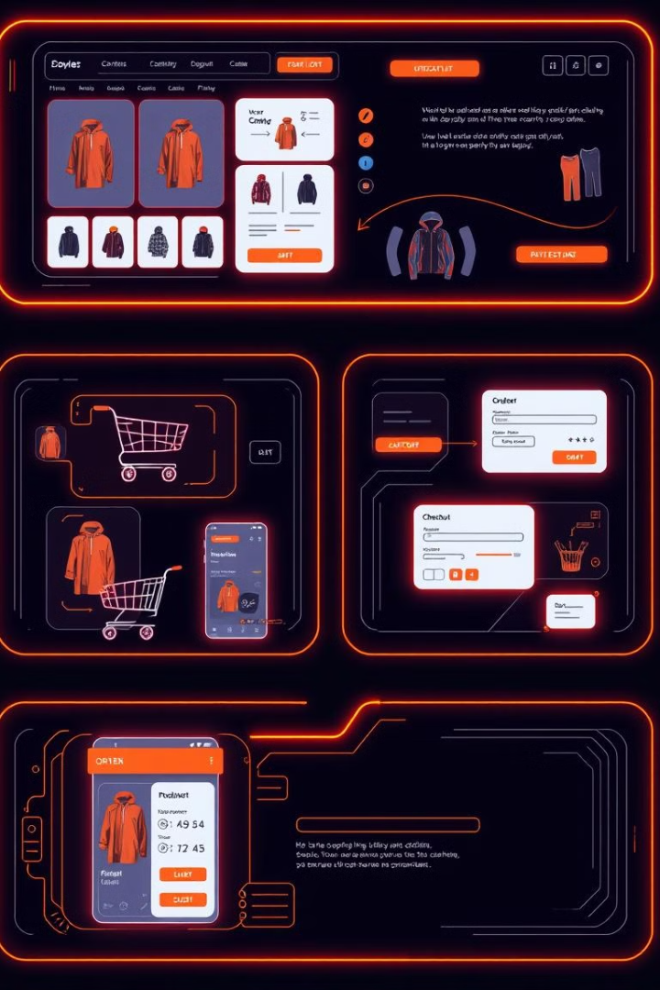
Demo

Slide 4

Reflection: Challenges & Questions
1
Connecting SSMS Server
2
Connecting Backend to Frontend
Establishing a secure and reliable connection between the database server and the web application.
Ensuring seamless communication and data flow between the server-side logic and the user interface.
3
What would you do different?
4
What would you do the same next time?

Slide 5
Risk Plan
Risk
Likelihood
Effect
Mitigation Plan
Database Connection Failure
High
Application crashes
Implement connection retries and fallback.
Invalid User Input
Medium
Incorrect data stored in DB
Validate user input on both frontend and backend.
Cart Total Calculation Error
Medium
Incorrect total amount displayed
Verify the calculation logic in the backend.
Browser Compatibility Issues
Low
Poor user experience
Test the website on multiple browsers.
Slow Page Load Times
Medium
Poor user experience
Optimize images and use lazy loading.

Slide 6

Thank You

